Slide 1

How do Cyclistic Member and Casual differ?

Slide 2
Table of content
Company Background
Business Challenge
Data
Analysis
Conclusion
Recommendation

Slide 3
Company Background
Formation and Industry
Formed in 2016, Cyclistic is a Chicago based Bike-share company.
Service
Cyclistic has over 5824 bicycles that are geotracked and locked into a network of 692 stations across Chicago.
Rider Category
Casual
Customers who purchase single-ride or ful-day passes are referred to as casual riders.
Member
Customers who purchase annual memberships are Cyclistic members.
Origin
Cyclistic is a fictional company made for this capstone project, based on the real Chicago bike- share company, Divvy.
Ride Passes
Cyclistic offers 3 ride passes:
single-ride passes
full-day passes
annual memberships.

Slide 4
Business Challenge
Our Goal
How annual members and casual riders differ.
Why casual riders would buy a membership.
Converting Casuals into Members is The key to future growth.
How digital media could affect their marketing tactics.
Create metrics that indicate how Members and Casuals ride differently.
Understand why Rider Category ride differently
Improve conversion of casual into Members

Slide 5
Data
Data Source
Cyclistic’s historical data comes from Divvy’s public available data
Data Volume
The merged data contains over 6012 million rows of data across 13 columns
Data limitations
Data privacy issues prohibit including riders personally identifiable information
Null values in the Station names
Timestamp errors in dataset
Missing information on which pass each rider category chose
Time Span
The past 12 months of data includes Sept 2025 _ Aug 2026.
Data Integrity
The 1st party data comes from a trustworthy source, vetted by Google as fit for use.

Slide 6
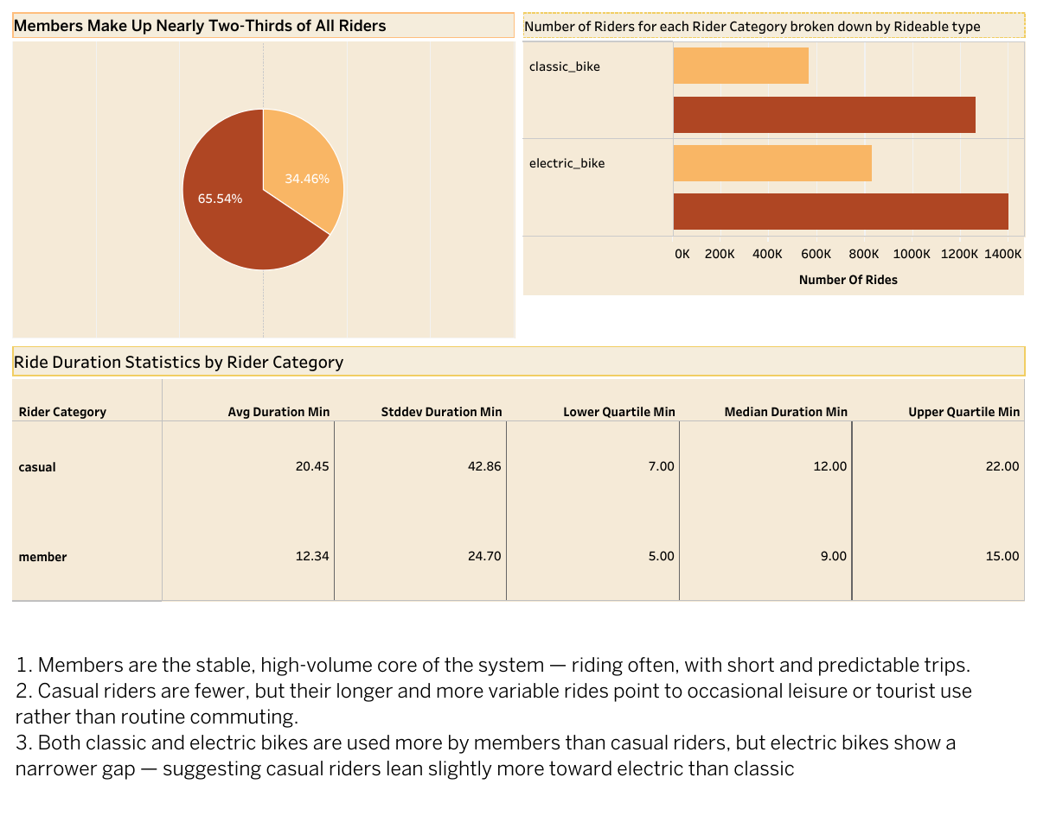

Slide 7
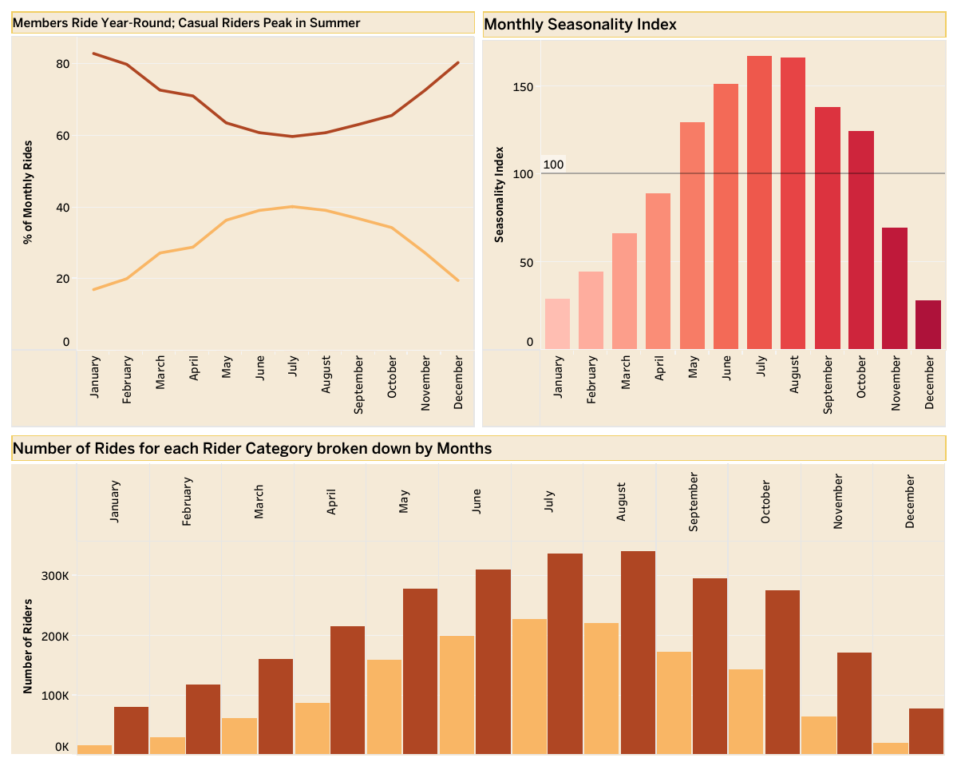

Slide 8
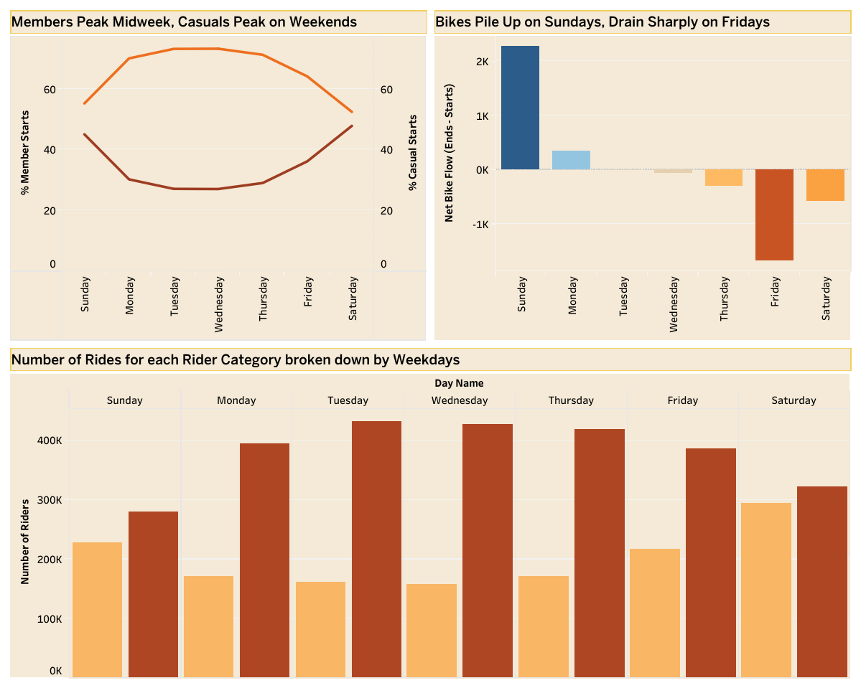

Slide 9
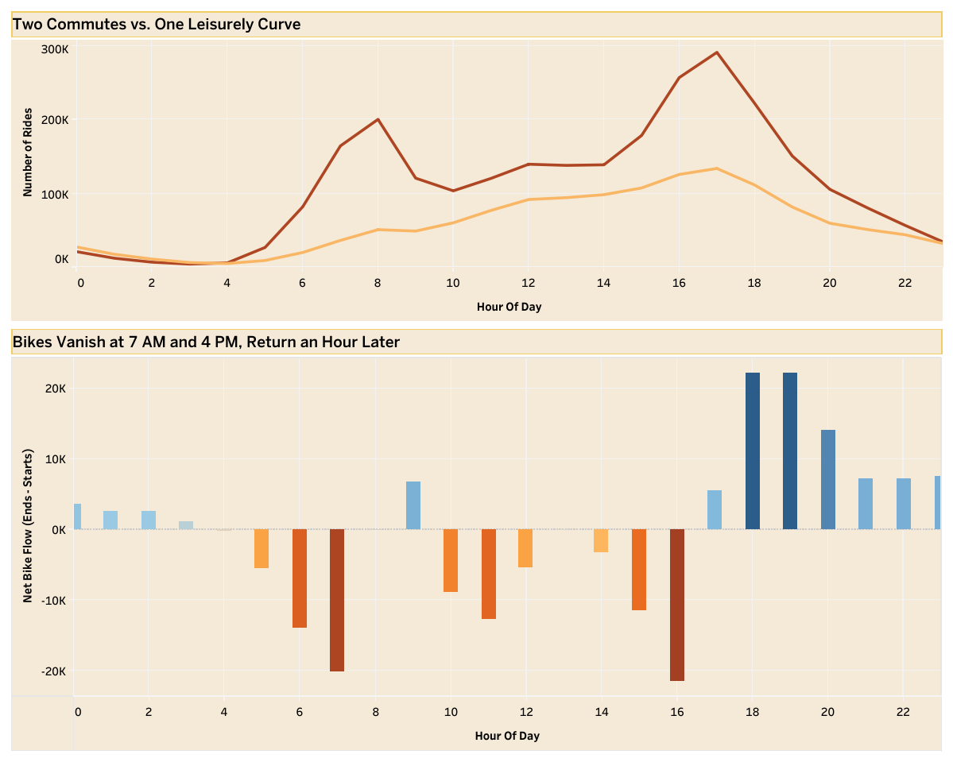

Slide 10
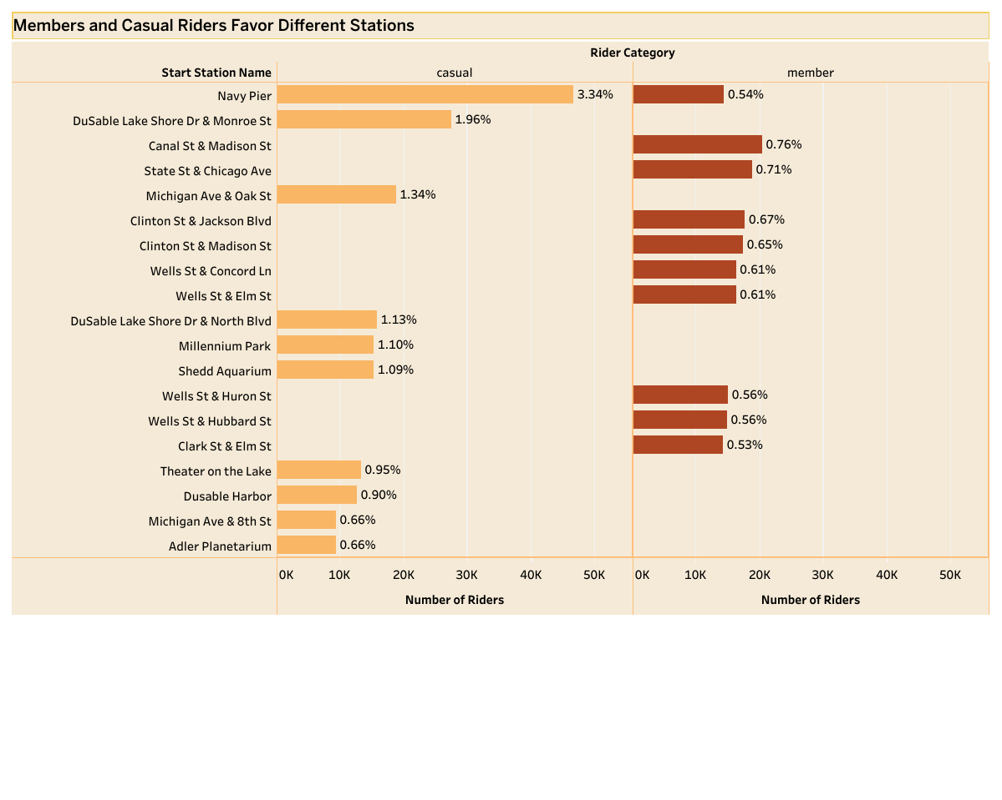

Slide 11
Key Findings
Rides
  Casual riders average almost double the trip length of members (20.45 min vs. 12.34 min)
  Casual ride times are far more unpredictable — stddev (42.86) is more than double the average itself, pointing to a handful of very long outlier trips rather than a typical usage pattern
When they ride — seasonal
  Members ride fairly consistently year-round (60–83% share), while casual share more than doubles across the year (17% in winter to 40% in summer) — the seasonal surge is driven disproportionately by leisure riders, not commuters.
  Ridership triples from winter to summer — Seasonality Index bottoms out around 25–30 in Dec/Jan and peaks near 165–168 in July
When they ride — weekly
  Members peak midweek (Tuesday–Wednesday, ~73% share)
  casual riders peak on weekends (~45–48% share on Sat/Sun) — a clean commuter-vs-leisure split.
Where they ride
  Zero overlap between top-10 stations by rider type. Casual riders cluster at lakefront/tourist landmarks (Navy Pier alone = 3.34% of all casual rides — over 6x the next station); members cluster at downtown business-district intersections with a much flatter distribution (top member station only 0.76%)
When they ride — hourly
  Members show two sharp commute peaks (~8 AM, ~5 PM)
  casual riders show one smooth midday-to-evening rise — the clearest visual proof of the commuter-vs-leisure divide in the whole analysis.

Slide 12
Recommendations
Station‑Level Targeting
  Focus conversion prompts at high‑traffic casual hubs such as Navy Pier, Millennium Park, and other top stations, rather than citywide. This ensures messaging reaches riders where casual usage is most concentrated
Leisure‑Oriented Membership Tier
  Create a special membership for riders who use bikes mainly for fun or weekend trips. Instead of focusing on commuter savings, highlight affordable options for longer, occasional leisure rides.
Seasonal Timing
  Launch campaigns in spring (April–May), just before the summer surge. This captures casual riders as their activity begins to climb, maximizing impact before peak season.
Cost Transparency Messaging
  Trigger real‑time prompts after long rides: “This ride cost $X — a membership would’ve been $Y.”
  Delivering this message at the pain point makes the value of membership tangible and immediate.

